Slide 1
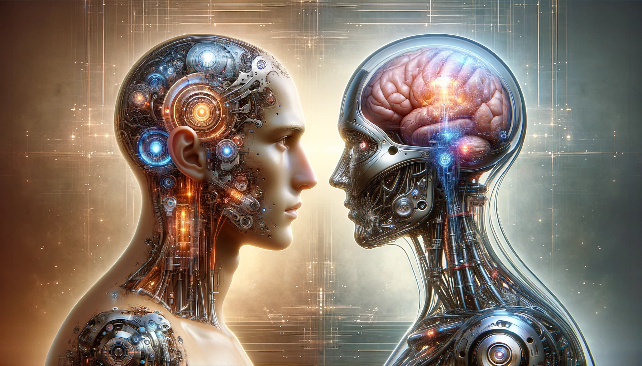
Humans as AI, AI as Humans

Slide 2
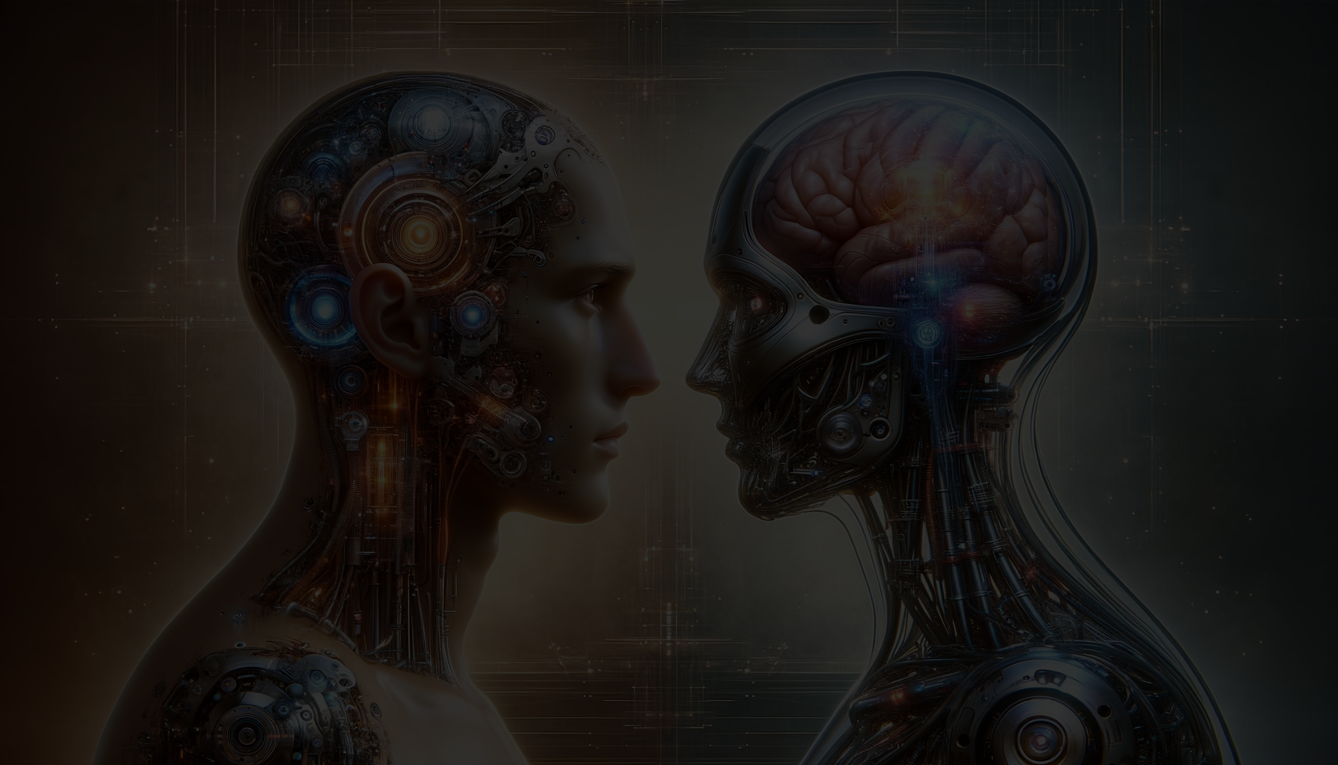
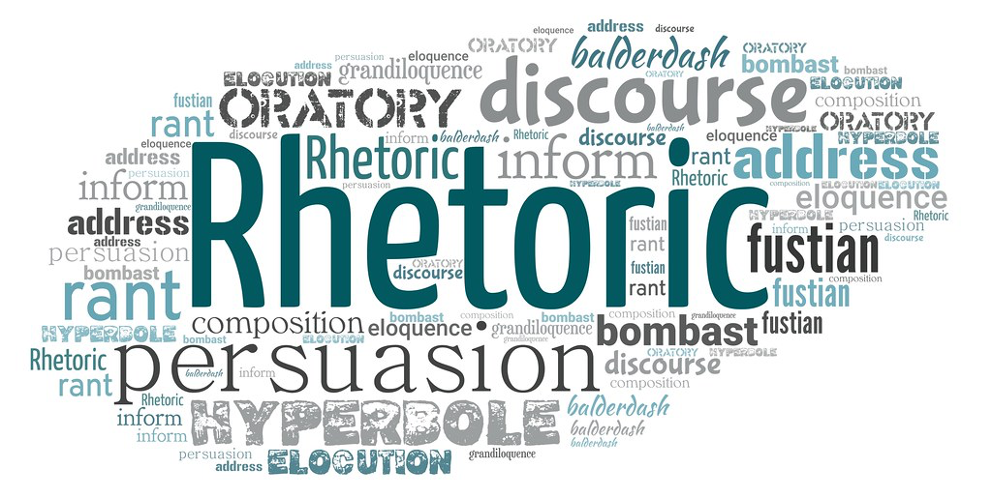
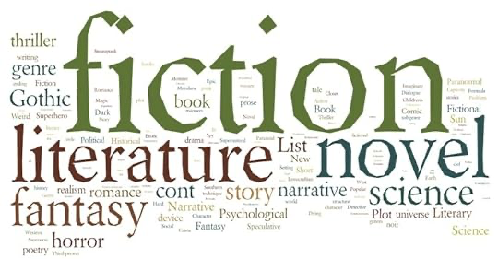
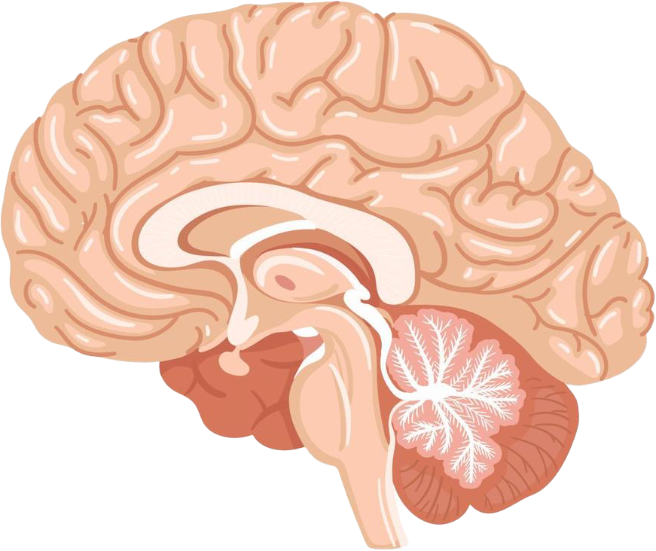
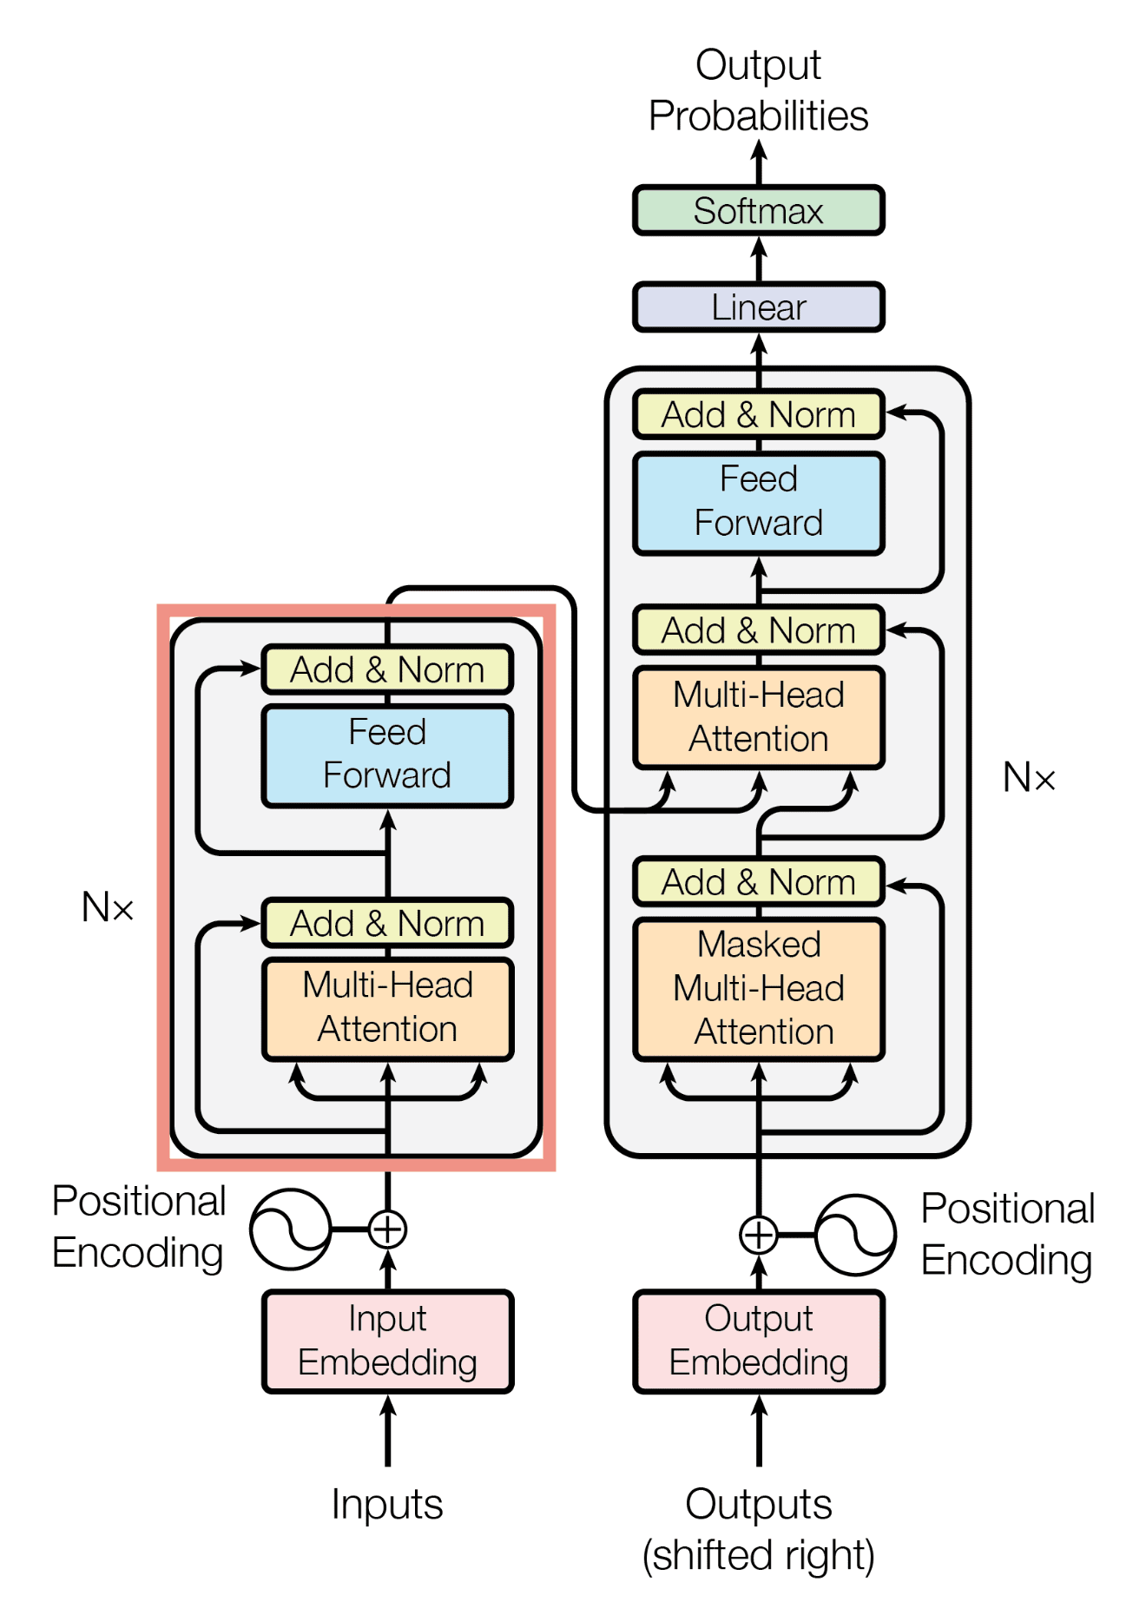
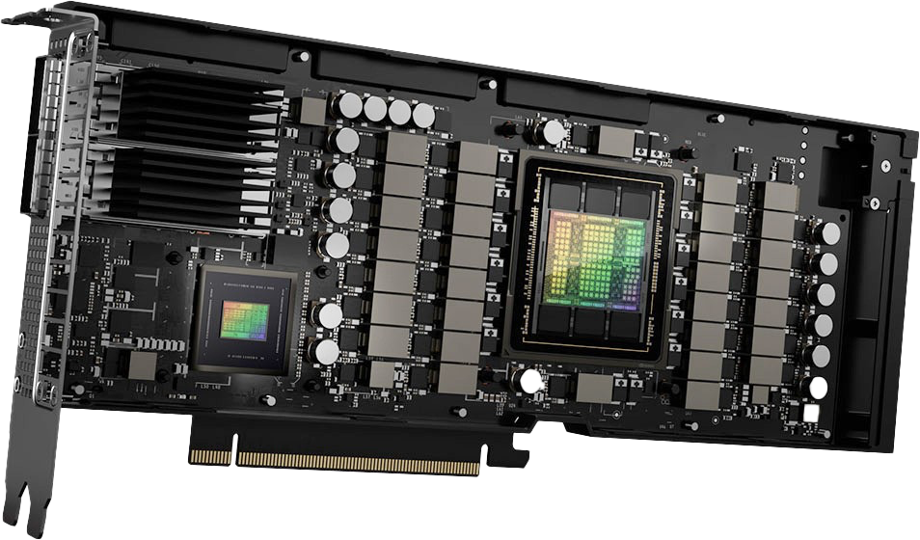
Complex
Human’s language
AI’s language
Fundamental, simple

Slide 3
Complex
Human’s language
AI’s language
?
?
Fundamental, simple

Slide 4
Complex
Human’s language
AI’s language
?
Not good
?
Fundamental, simple

Slide 5
Complex
Human’s language
AI’s language
?
HSS319
?
Fundamental, simple

Slide 6
Complex
Human’s language
AI’s language
?
Q2
?
Q1
Fundamental, simple

Slide 7
Complex
Human’s language
AI’s language
Q1. From the perspective of AI, how do humans speak and write?
?
Q2
?
Q1
Fundamental, simple

Slide 8
Complex
Human’s language
AI’s language
?
Q2
Q2. From the perspective of humans, how does AI generate text?
?
Q1
Fundamental, simple

Slide 9
https://www.llm-vs-human.com

